Slide 1
16CSE09 / Machine Learning Techniques
Unit – 2
CO-2: Utilize regression and classification algorithms
Session – 4
Topic:
Multiple Linear Regression
Qualitative Predictors

Slide 2
Multiple Linear Regression
Multiple linear regression (MLR), also known simply as multiple regression, is a statistical technique that uses several explanatory variables to predict the outcome of a response variable.
The goal of multiple linear regression (MLR) is to model the linear relationship between the explanatory (independent) variables and response (dependent) variable.
MLR is used extensively in economics and financial inference.

Slide 3
Multiple Linear Regression
In multiple linear regression, it is possible that some of the independent variables are actually correlated with one another, so it is important to check these before developing the regression model.
If two independent variables are too highly correlated (r > ~0.6), then only one of them should be used in the regression model.

Slide 4

Multiple linear regression formula
The regression model is
y = the predicted value of the dependent variable
B₀ = the y-intercept (value of y when all other parameters are set to 0)
β₁X₁= the regression coefficient (β₁) of the first independent variable (X₁) (the effect that increasing the value of the independent variable has on the predicted y value)
…
β_{n}X_{n} = the regression coefficient of the last independent variable
e = model error (how much variation there is in our estimate of y)

Slide 5
Multiple linear regression …
When we perform multiple linear regression, we usually are interested in answering a few important questions.
1. Is at least one of the predictors X1,X2, . . . , Xp useful in predicting the response?
2. Do all the predictors help to explain Y , or is only a subset of the predictors useful?
3. How well does the model fit the data?
4. Given a set of predictor values, what response value should we predict, and how accurate is our prediction?

Slide 6
Example for Multiple linear regression
We interpret β_{j} as the average effect on Y of a one unit increase in X _{j} , holding all other predictors fixed.
In the advertising example, predicting sales:
Predicting Weight by Height and Age
Weight = β₀ + β₁ X Height + β₂ X Age + εi

Slide 7
Example for Multiple linear regression
For a sample of n college students, the following variables were measured:
Y = height, X₁ = mother’s height, X₂ = father’s height, X₃ = 1 if male, 0 if female (“male”)
Goal is to predict student’s height using the mother’s and father’s heights, and sex, where sex is categorized using the variable “male” = 1 if male, 0 if female.
The population model is Y_{i} = β₀ + β₁X_{i1} + β₂X_{i2} + β₃X_{i3} + εi

Slide 8
Example for Multiple linear regression
For a sample of n=5 college students, the following variables were measured:
Y = height, X₁ = mother’s height, X₂ = father’s height
predict student’s height using the mother’s and father’s heights
The regression model is Y_{i} = β₀ + β₁ X Mother’s Height + β₂ X Father’s Height + ε
S.No | Y | X₁ | X₂
1 | 55 | 53 | 56
2 | 62 | 60 | 64
3 | 70 | 65 | 72
4 | 68 | 66 | 67
5 | 65 | 64 | 67

Slide 9
Example for Multiple linear regression
For a sample of n=7, the following variables were measured to analyze performance of a delivery person.
X₁ = miles travelled, X₂ = number of deliveries, Y = Travel time in Hrs
Predict the performance using X1 & X2
S.No | X₁ | X₂ | Y
1 | 89 | 4 | 7
2 | 66 | 1 | 5.4
3 | 78 | 3 | 6.6
4 | 44 | 1 | 4.8
5 | 80 | 3 | 7
6 | 66 | 2 | 5.6
7 | 73 | 3 | 6.4

Slide 10
Example for Multiple linear regression
The regression model is
Y_{i} = β₀ + β₁ X Miles travelled + β₂ X Number of deliveries + ε

Slide 11
Qualitative Predictors
All variables in our linear regression model are quantitative.
But in practice often some predictors are qualitative
Credit data set records - quantitative predictors: balance (average credit card debt for a number of individuals), age, cards (number of credit cards), education (years of education), income (in thousands of dollars), limit (credit limit), and rating (credit rating).
In addition to these quantitative variables, we also have qualitative variables: gender, student (student status), and status (marital status).

Slide 12
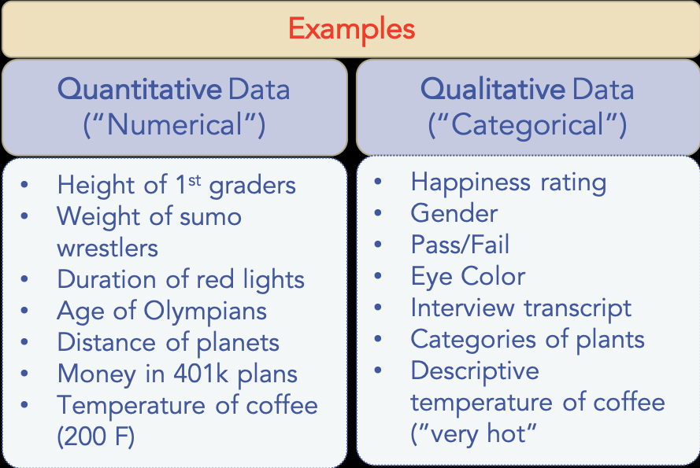
Quantitative Vs Qualitative Predictors

Slide 13
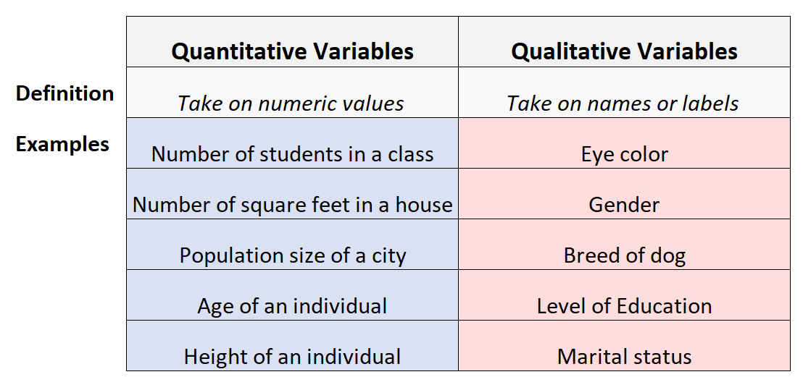

Slide 14

Predictors with Only Two Levels
to investigate differences in credit card balance between males and females, ignoring the other variables
If a qualitative predictor only has two levels, then incorporating it into a regression model is very simple.
For example, based on the gender variable, we can create a new variable that takes the form.
and use this variable as a predictor in the regression equation.

Slide 15

Predictors with Only Two Levels…
This results in the model
Now β₀ can be interpreted as the average credit card balance among males, β ₀ + β₁ as the average credit card balance among females, and β₁ as the average difference in credit card balance between females and males.

Slide 16


Predictors with Only Two Levels…
instead of a 0/1 coding scheme, we could create a dummy variable
and use this variable in the regression equation. This results in the model
Now β₀ can be interpreted as the overall average credit card balance (ignoring the gender effect), and β₁ is the amount that females are above the average and males are below the average.

Slide 17


Predictors with More than Two Levels…
When a qualitative predictor has more than two levels, a single dummy variable cannot represent all possible values. In this situation, we can create additional dummy variables.
For example, for the ethnicity variable we create two dummy variables. The first could be,
and the second could be,

Slide 18
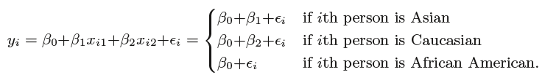
Predictors with More than Two Levels…
Then both of these variables can be used in the regression equation, in order to obtain the model,

Slide 19
Summary
Summary
Multiple Linear Regression
Quantitative Vs Qualitative Predictors
Predictors with two levels and more than two levels
Thank You

